Slide 1
Algorithms: Brute Force and Exhaustive Search
For: CSCI 163A / COEN 179
By: Navid Shaghaghi

Slide 2
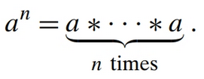
Brute Force
A straightforward approach to solving a problem, usually based directly on the problem’s statement and definitions of the concepts involved.
Example:
Unlike some of the other strategies, brute force is applicable to a very wide variety of problems.
For some important problems—e.g., sorting, searching, matrix multiplication, string matching— the brute-force approach yields reasonable algorithms of at least some practical value with no limitation on instance size.

Slide 3
Brute Force
The expense of designing a more efficient algorithm may be unjustifiable if
only a few instances of a problem need to be solved and
a brute-force algorithm can solve those instances with acceptable speed.
Even if too inefficient in general, a brute-force algorithm can still be useful for solving small-size instances of a problem.
A brute-force algorithm can serve an important theoretical or educational purpose as a yardstick with which to judge more efficient alternatives for solving a problem.

Slide 4
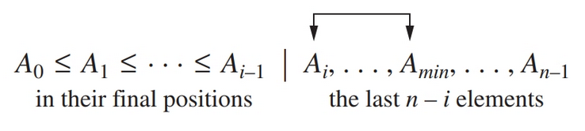
Selection Sort
Scan the array to find its smallest element and swap it with the first element. Then, starting with the second element, scan the elements to the right of it to find the smallest among them and swap it with the second elements.
Generally, on pass i (0 ≤ i ≤ n-2), find the smallest element in A[i..n-1] and swap it with A[i]:
Example: 7 3 2 5

Slide 5
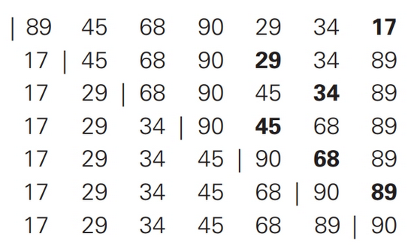
Selection Sort Example

Slide 6
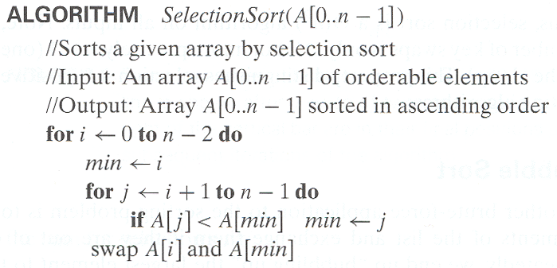
Selection Sort Algorithm

Slide 7
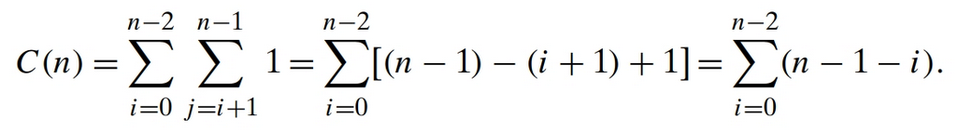
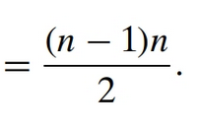
Selection Sort Time Analysis

Slide 8
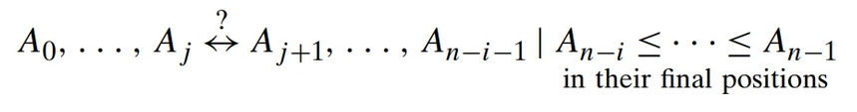
Bubble Sort
Compare adjacent elements of the list and exchange them if they are out of order. By doing it repeatedly, we end up “bubbling up” the largest element to the last position on the list. The next pass bubbles up the second largest element, and so on, until after n − 1 passes the list is sorted.
Pass i (0 ≤ i ≤ n − 2) of bubble sort can be represented by the following diagram:
If it were not for its catchy name, you would probably have never heard of it

Slide 9
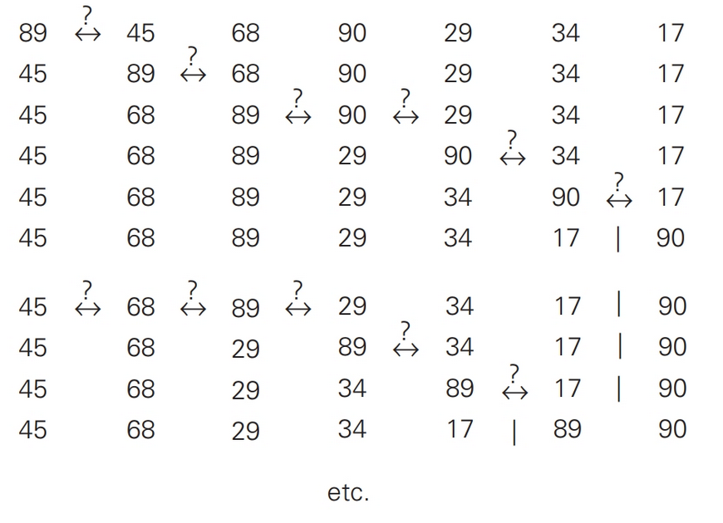
Bubble Sort Example

Slide 10
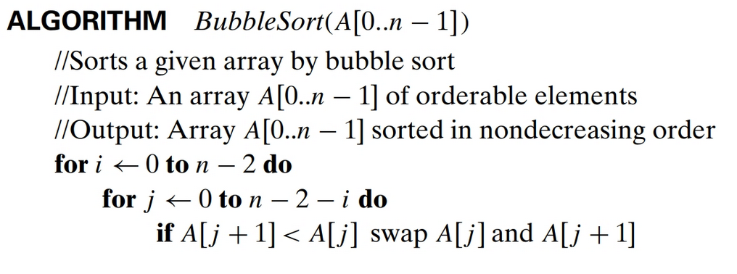
Bubble Sort Algorithm

Slide 11
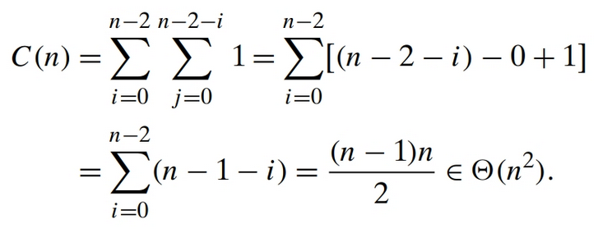
Bubble Sort Time Efficiency

Slide 12
Sequential Search
Compares successive elements of a given list with a given search key until either a match is encountered (successful search) or the list is exhausted without finding a match (unsuccessful search).
Enhancements:
If we append the search key to the end of the list, the search for the key will have to be successful, and therefore we can eliminate the end of list check altogether.
If a given list is known to be sorted: searching in such a list can be stopped as soon as an element greater than or equal to the search key is encountered.

Slide 13
Brute-Force String Matching
pattern: a string of m characters to search for
text: a (longer) string of n characters to search in
problem: find a substring in the text that matches the pattern
Brute-force algorithm
Step 1 Align pattern at beginning of text
Step 2 Moving from left to right, compare each character of pattern to the corresponding character in text until
all characters are found to match (successful search); or
a mismatch is detected
Step 3 While pattern is not found and the text is not yet exhausted, realign pattern one position to the right and repeat Step 2

Slide 14
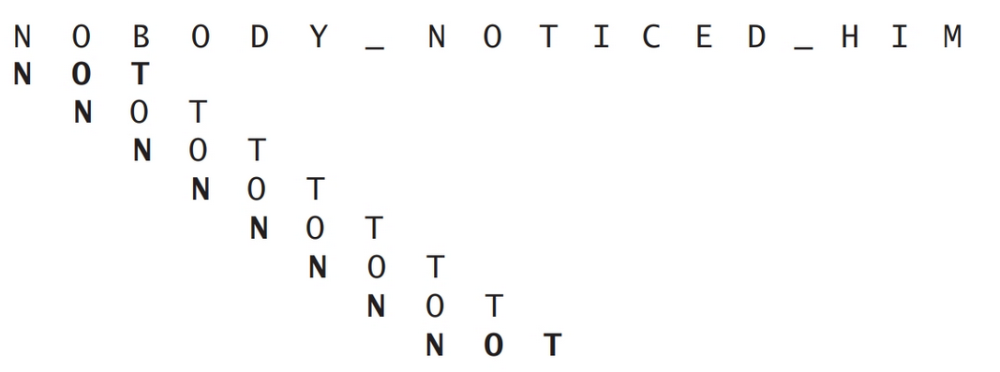
Example of Brute-Force String Matching

Slide 15
Example of Brute-Force String Matching
Text: 10010101101001100101111010
Pattern: 001011

Slide 16
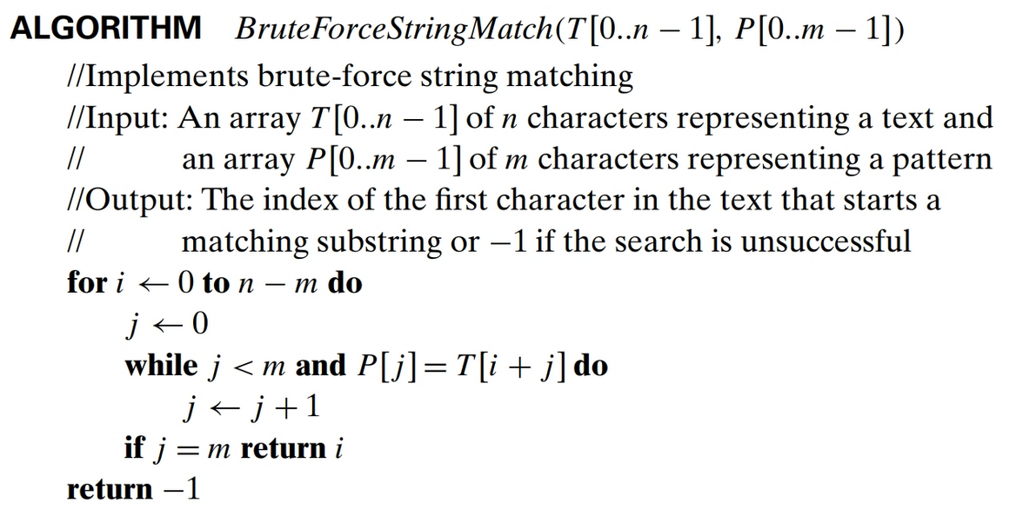
Brute-Force String Matching Algorithm
Time Efficiency:
m * (n – m + 1) which puts it in the O(nm) efficiency class.
How did we calculate that?

Slide 17
Brute-Force Polynomial Evaluation
Problem: Find the value of polynomial p(x) = a_{n}x^{n} + a_{n-1}x^{n-1} +… + a₁x¹ + a₀ at a point x = x₀
Brute-force algorithm:
p ← 0.0
for i ← n down to 0 do
power ← 1
for j ← 1 to i do //compute x^{i}
power ← power ∗ x
p ← p + a[i] ∗ power
Return p

Slide 18
Polynomial Evaluation: Improvement
We can do better by evaluating from right to left:
p ← a[0]
power ← 1
for i ← 1 to n do
power ← power ∗ x
p ← p + a[i] ∗ power
return p

Slide 19
Closest-Pair Problem
Find the two closest points in a set of n points (in the two-dimensional Cartesian plane).
Brute-force algorithm:
Compute the distance between every pair of distinct points
and return the indexes of the points for which the distance is the smallest.

Slide 20
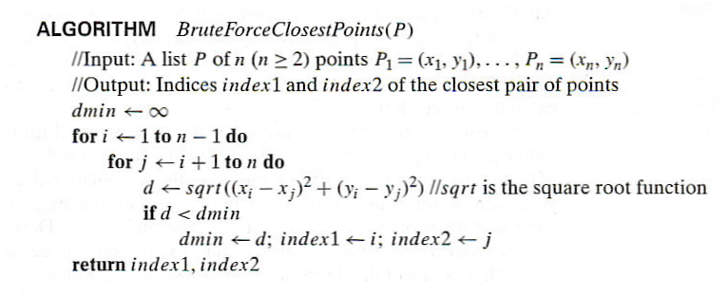
Closest-Pair Brute-Force Algorithm

Slide 21
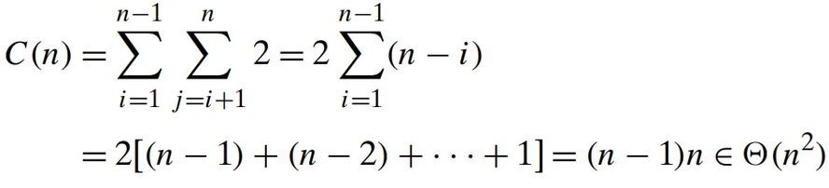
Closest-Pair Brute-Force Time Efficiency

Slide 22
Brute-Force Strengths and Weaknesses
Strengths
wide applicability
simplicity
yields reasonable algorithms for some important problems (e.g., matrix multiplication, sorting, searching, string matching)
Weaknesses
rarely yields efficient algorithms
some brute-force algorithms are unacceptably slow
not as constructive as some other design techniques

Slide 23
Exhaustive Search
A brute force solution to a problem involving search for an element with a special property, usually among combinatorial objects such as permutations, combinations, or subsets of a set.
Method:
generate a list of all potential solutions to the problem in a systematic manner
evaluate potential solutions one by one, disqualifying infeasible ones and, for an optimization problem, keeping track of the best one found so far
when search ends, announce the solution(s) found

Slide 24
Continue on slides 13 through 28 of Levitin Ch03

